Slide 1




PUBLIC TRANSPORTATION EFFICIENCY ANALYSIS
Team members:
JAYAPRIYADHARSHINI.V-au211521106068
SANDHIYA.P- au211521106132
DEEPIKA.R- au211521106030
HAYANTHIKA.S- au211521106058

Slide 2
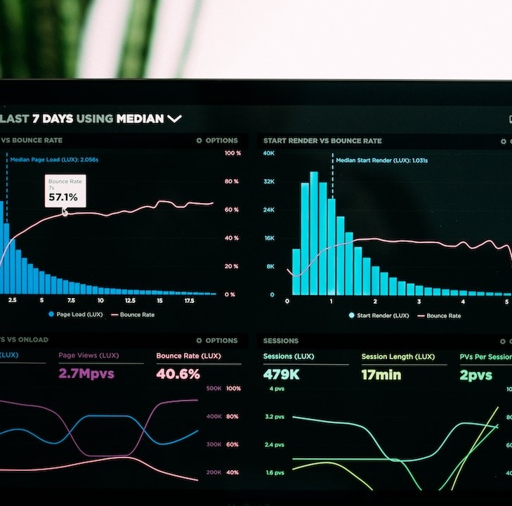
Introduction
As cities continue to face the growing challenge of improving their public transportation systems, data analytics emerges as a promising solution. By harnessing the power of data, public transport authorities can now analyze various factors that affect efficiency and make informed decisions to enhance the overall performance. This article explores the critical role of data analytics in improving public transport efficiency and its potential to transform the way we commute.

Slide 3

Problem definition:
Problem Definition: "Improving Public Transportation efficiency and Reliability"
Public transportation is a vital component of urban infrastructure, yet it faces persistent challenges that hinder its effectiveness. The problem of public transportation encompasses the need to enhance accessibility and reliability for passengers while addressing key issues such as congestion, environmental impact, and equitable service provision.

Slide 4

Key components of this problem include:
1. Accessibility: Ensuring that public transportation is available and convenient for all members of the community, including those with disabilities, the elderly, and those without access to private vehicles.
2. Reliability: Minimizing delays, service interruptions, and unpredictability in public transportation schedules to provide passengers with consistent and dependable service.
3. Congestion: Managing and reducing traffic congestion on urban roadways by promoting the use of public transportation as a viable alternative to private vehicles.
4. Environmental Impact: Mitigating the environmental footprint of public transportation by promoting cleaner technologies and implementing sustainable practices.

Slide 5

Definition of Public Transport Efficiency
Public transport efficiency refers to the ability of a public transportation system to provide reliable, timely, and convenient services to commuters while maximizing resources and minimizing environmental impact. It involves analyzing factors such as punctuality, frequency, connectivity, capacity utilization, and customer satisfaction to identify areas for improvement and optimize the system's performance. Data analytics plays a crucial role in measuring and understanding these factors, enabling authorities to make data-driven decisions for enhancing overall efficiency and creating a seamless commuting experience.

Slide 6
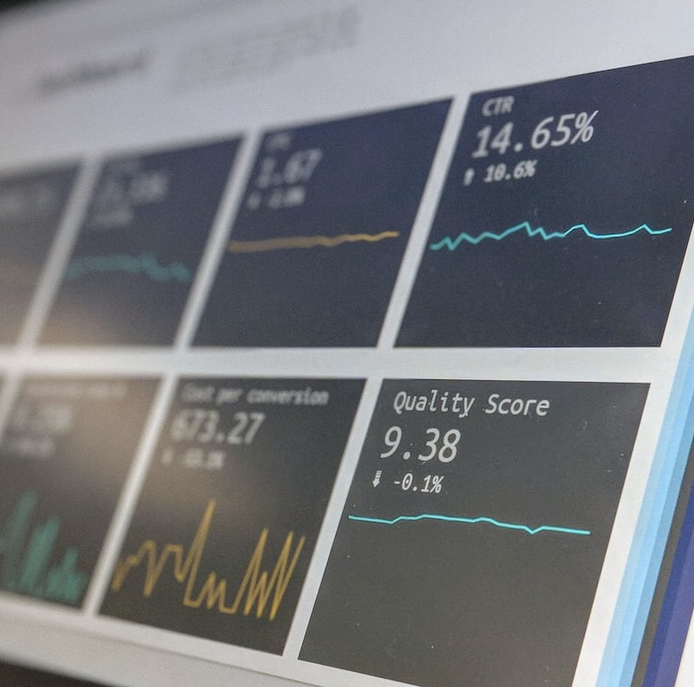
DESIGN THINKING:
STEPS TO SOLVE THE PROBLEM:
1.Problem Identification:
- Identify specific issues within public transportation, such as delays, overcrowding, or route optimization, that data analytics can help address.
2.Data Collection:
- Gather relevant data from various sources, including GPS tracking, ticketing systems, maintenance records, and customer feedback.
3. Data Cleaning and Preparation:
- Clean and preprocess the collected data to remove inconsistencies, missing values, and errors.
- Format data for analysis and ensure it's in a suitable structure for modeling.
4. Exploratory Data Analysis (EDA):
- Conduct EDA to gain insights into the data. Visualize data patterns, correlations, and anomalies.
- Identify key variables and factors that may contribute to transportation issues.

Slide 7
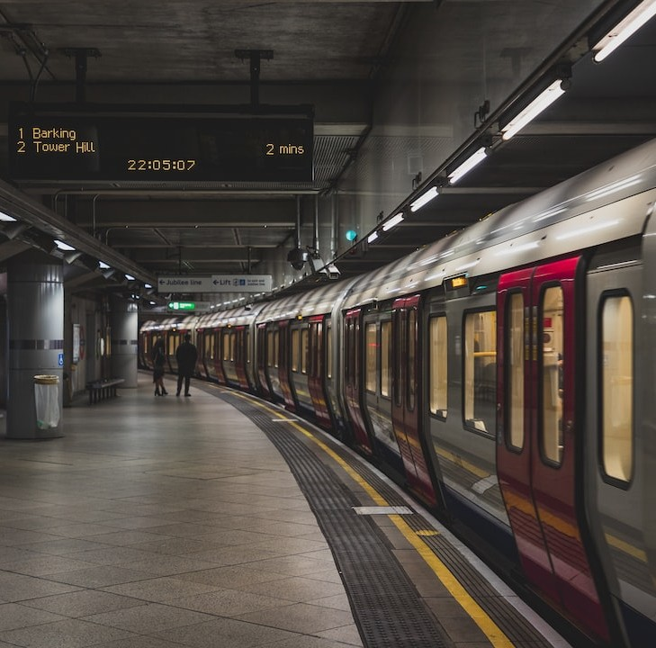
5. Model Selection:
- Choose appropriate data analytics and machine learning models based on the problem you're addressing.
- Common models include regression for demand forecasting, clustering for route optimization, and time series analysis for scheduling.
6. Feature Engineering:
-Create or transform features that are relevant to your modelling task.
7. Model Training:
- Train the selected models on historical data to learn patterns and relationships.
- Use a portion of the data for training and reserve another portion for testing and validation.
8. Model Evaluation:
- Assess the performance of your models using appropriate metrics. For example, Mean Absolute Error (MAE) for regression or F1-score for classification tasks.
- Fine-tune models and hyperparameters to improve their accuracy

Slide 8

9.Deployment:
-Implement the data analytics solutions into the public transportation system.
10. Monitoring and Maintenance:
- Continuously monitor the performance of your data analytics solutions in a real-world environment.
- Implement alerts and triggers to identify and address issues as they arise.
11.Feedback Loop:
- Gather user feedback and data on the effectiveness of your solutions.
- Use this feedback to make necessary adjustments, updates, and improvements to your data analytics models and processes.
12. Scale and Iterate:
- If successful, consider scaling the solutions to cover a larger portion of the transportation network.
- Continue to iterate and refine your models as new data becomes available or as transportation needs evolve.

Slide 9

vv
13. Policy and Decision Making:
- Share insights and recommendations derived from data analytics with transportation authorities and policymakers to inform decisions related to infrastructure, routes, and services.
14. Public Communication:
- Communicate improvements and changes to the public, ensuring transparency and addressing concerns or feedback.

Slide 10

Conclusion
Data analytics holds the key to enhancing public transport efficiency. By incorporating data-driven strategies, transportation systems can achieve better route planning, reduced congestion, improved passenger satisfaction, and increased cost savings.
Moreover, data analytics enables transport operators to prioritize safety and security measures, making public transport a key player in sustainable urban development.

